Slide 1
Graph Algorithm
HAMILTON GRAPHS

Slide 2
Introduction
Can we travel along the edges of a graph starting at a vertex and returning to it by traversing each edge of the graph exactly once?
Can we travel along the edges of a graph starting at a vertex and returning to it while visiting each vertex of the graph exactly once
Both questions have many practical applications in many different areas

Slide 3
Hamiltonian Graphs
A Hamiltonian cycle is a cycle that contains all vertices in a graph G.
If a graph has a Hamiltonian cycle, then the graph G is said to be Hamiltonian.
“ A graph G=(V(G),E(G)) is considered Hamiltonian if and only if the graph has a cycle containing all of the vertices of the graph. “

Slide 4
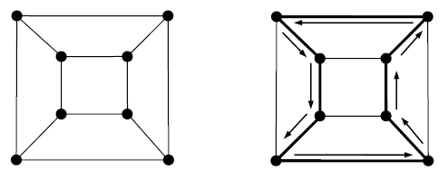
Hamiltonian Paths And Circuits
If there exists a walk in the connected graph that visits every vertex of the graph exactly once without repeating the edges, then such a walk is called as a Hamiltonian path/walk.
In Hamiltonian path, all the edges may or may not be covered but edges must not repeat.
A Hamiltonian circuit in a connected graph is defined as a closed walk that traverses every vertex of graph G exactly once except starting and terminal vertex.

Slide 5
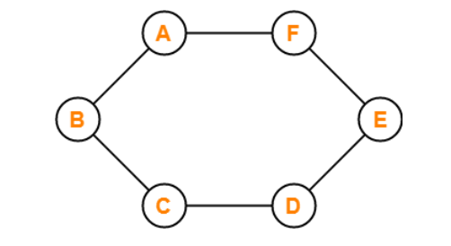
Hamiltonian Paths And Circuits
This graph contains
a closed walk ABCDEFA.
It visits every vertex of the
graph exactly once except starting vertex.
The edges are not repeated
during the walk.
Therefore, it is a Hamiltonian
graph.

Slide 6
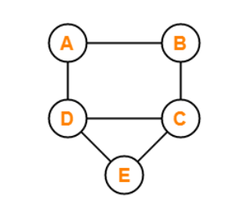
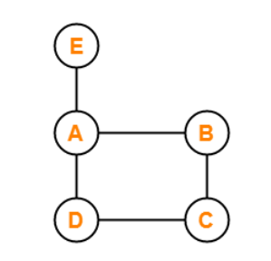
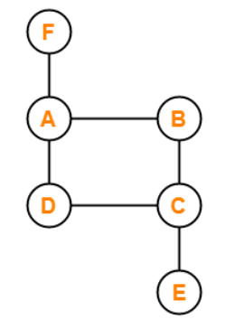







Slide 7
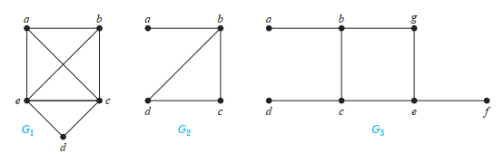
G1 has a Hamilton circuit: a, b, c, d, e, a.
No Hamilton circuit in G2 (any circuit containing every vertex must contain the edge {a, b} twice), but G2 does have a Hamilton path a, b, c, d.
G3 has neither a Hamilton circuit nor a Hamilton path, because any path containing all vertices must contain one of the edges {a, b}, {e, f }, and {c, d} more than once

Slide 8
Hamiltonian Paths And Circuits
Any Hamiltonian circuit can be converted to a Hamiltonian path by removing one of its edges.
Every graph that contains a Hamiltonian circuit also contains a Hamiltonian path but vice versa is not true.
There may exist more than one Hamiltonian paths and Hamiltonian circuits in a graph.

Slide 9
CONDITION FOR HAMILTON CIRCUITS
There are no known simple necessary and sufficient criteria for the existence of Hamilton circuits.
Many theorems are known that give sufficient conditions for the existence of Hamilton circuits.
Certain properties can be used to show that a graph has no Hamilton circuit.
A graph with a vertex of degree one cannot have a Hamilton circuit, because in a Hamilton circuit, each vertex is incident with two edges in the circuit.
If a vertex in the graph has degree two, then both edges that are incident with this vertex must be part of any Hamilton circuit.
When a Hamilton circuit is being constructed and this circuit has passed through a vertex, then all remaining edges incident with this vertex, other than the two used in the circuit, can be removed from consideration.
A Hamilton circuit cannot contain a smaller circuit within it

Slide 10
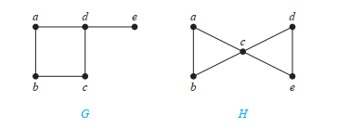
Based on previous points mentioned can one identify if graph G and H have Hamilton circuit or not
There is no Hamilton circuit in G because G has a vertex of degree one, namely, e.
If consider H. Because the degrees of the vertices a, b, d, and e are all two, every edge incident with these vertices must be part of any Hamilton circuit.
But there is no Hamilton circuit that can exist in H,
because for any Hamilton circuit would have to contain four edges incident with c, which is impossible as C is repeated

Slide 11
CONDITION FOR HAMILTON CIRCUITS
DIRAC’S THEOREM
If G is a simple graph with n vertices with n ≥ 3 such that the degree of every vertex in G is at least n/2, then G has a Hamilton circuit.

Slide 12
CONDITION FOR HAMILTON CIRCUITS
ORE’S THEOREM
If G is a simple graph with n vertices with n ≥ 3 such that deg(u) + deg(v) ≥ n for every pair of nonadjacent vertices u and v in G, then G has a Hamilton circuit
* Both Ore’s theorem and Dirac’s theorem provide sufficient conditions for a connected simple graph to have a Hamilton circuit. However, these theorems do not provide necessary conditions for the existence of a Hamilton circuit.

Slide 13
Application of Hamilton Graphs
Many applications ask for a path or circuit that visits each road intersection in a city, each place pipelines intersect in a utility grid, or each node in a communications network exactly once.
The famous traveling salesperson problem or TSP (also known in older literature as the traveling salesman problem) asks for the shortest route a traveling salesperson should take to visit a set of cities.

Slide 14



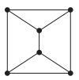
For each of these graphs, determine whether Dirac’s theorem can be used to show that the graph has a Hamilton circuit.
If it does have Hamilton Circuit, find such a circuit. If it does not, give an argument to show why no such circuit exists
Graph G1
Graph G2
Graph G3
Graph G4

